Slide 1
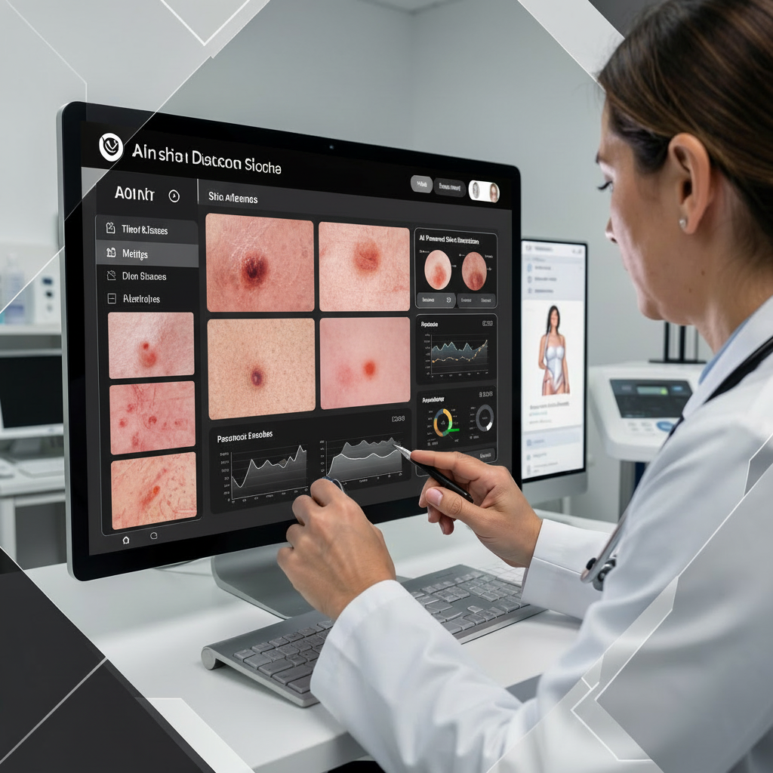
AI-Based Intelligent System for Skin Disease Detection and Healthcare Recommendation
Mentor: Mr. Hemanth Reddy
Co-ordinator: Ms.Sushma
This AI-powered system is designed for skin disease detection, utilizing image-based diagnosis through machine learning model . It also provides healthcare recommendations, including support for finding nearby clinics.
The project operates within the domain of Artificial Intelligence and Machine Learning.

Slide 2



Project Overview
Problem Statement
Objective of the Project
Target Users
Lack of early and accurate skin disease diagnosis
Classify skin diseases using AI models
General users
Patients in remote or underserved areas
Limited access to dermatologists
Assist users with healthcare recommendations
Healthcare assistance platforms
Difficulty in finding nearby specialized clinics
Help users locate nearby dermatology clinics

Slide 3












Technology Stack
Backend (Server)
Machine Learning Layer
Frontend (Client)
FastAPI
CNN and Skinclip based skin disease classifier
React.js
Python
Ensemble-ready prediction architecture
Tailwind CSS
RESTful APIs
Image preprocessing pipeline
Responsive Web UI
Database & Storage
External Services
Supabase
Google Maps API (hospital & clinic discovery)
PostgreSQL
Object Storage for images

Slide 4
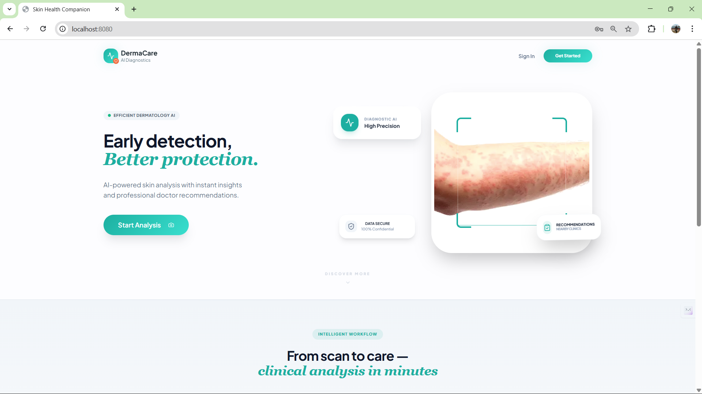
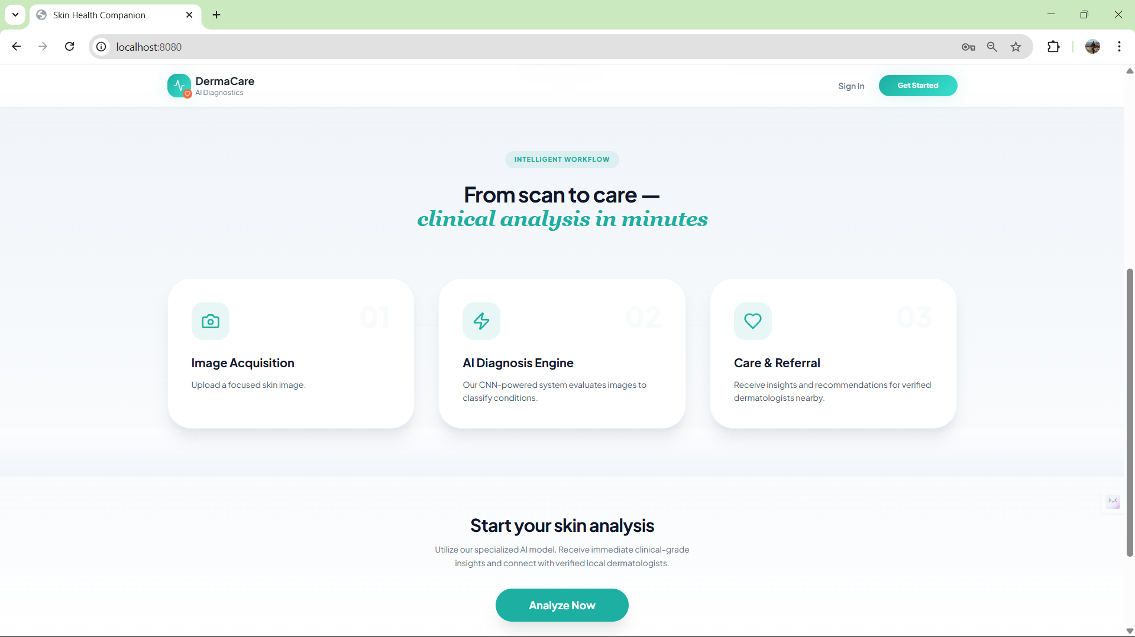
Results:
Home Page

Slide 5
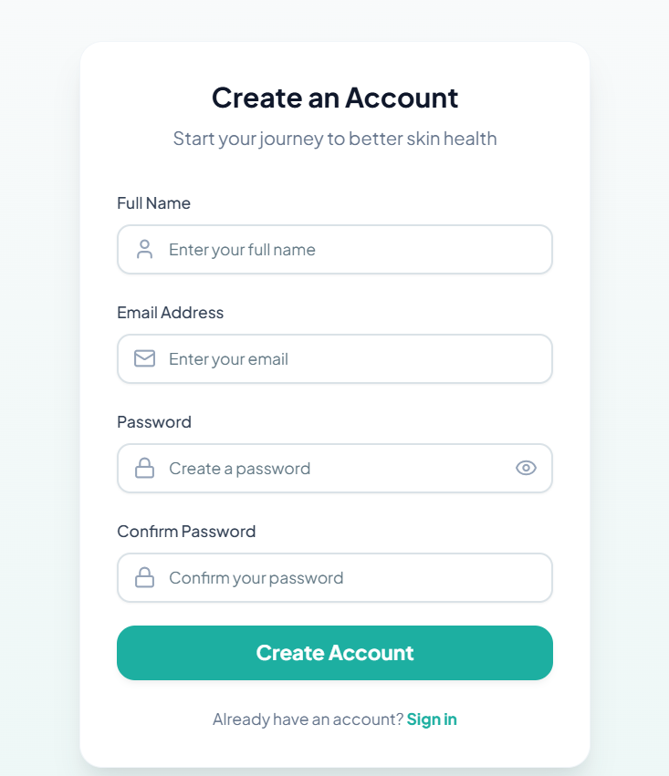
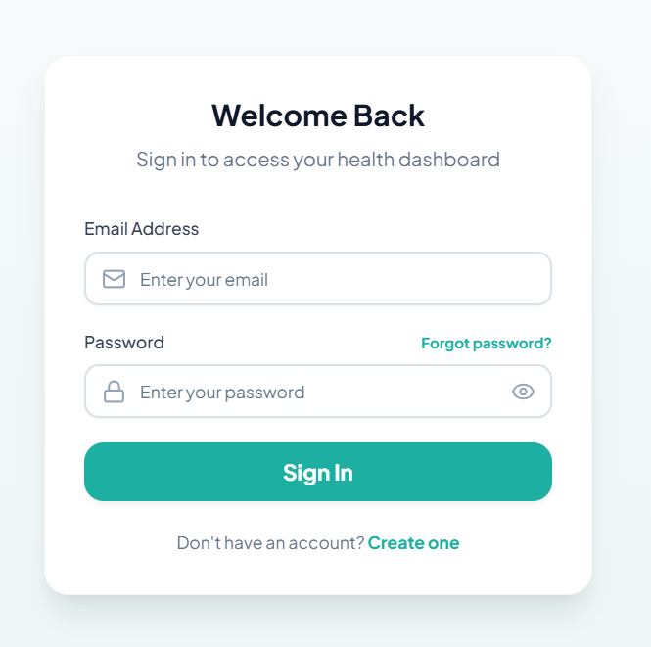
Results:
Sign Up and Login

Slide 6
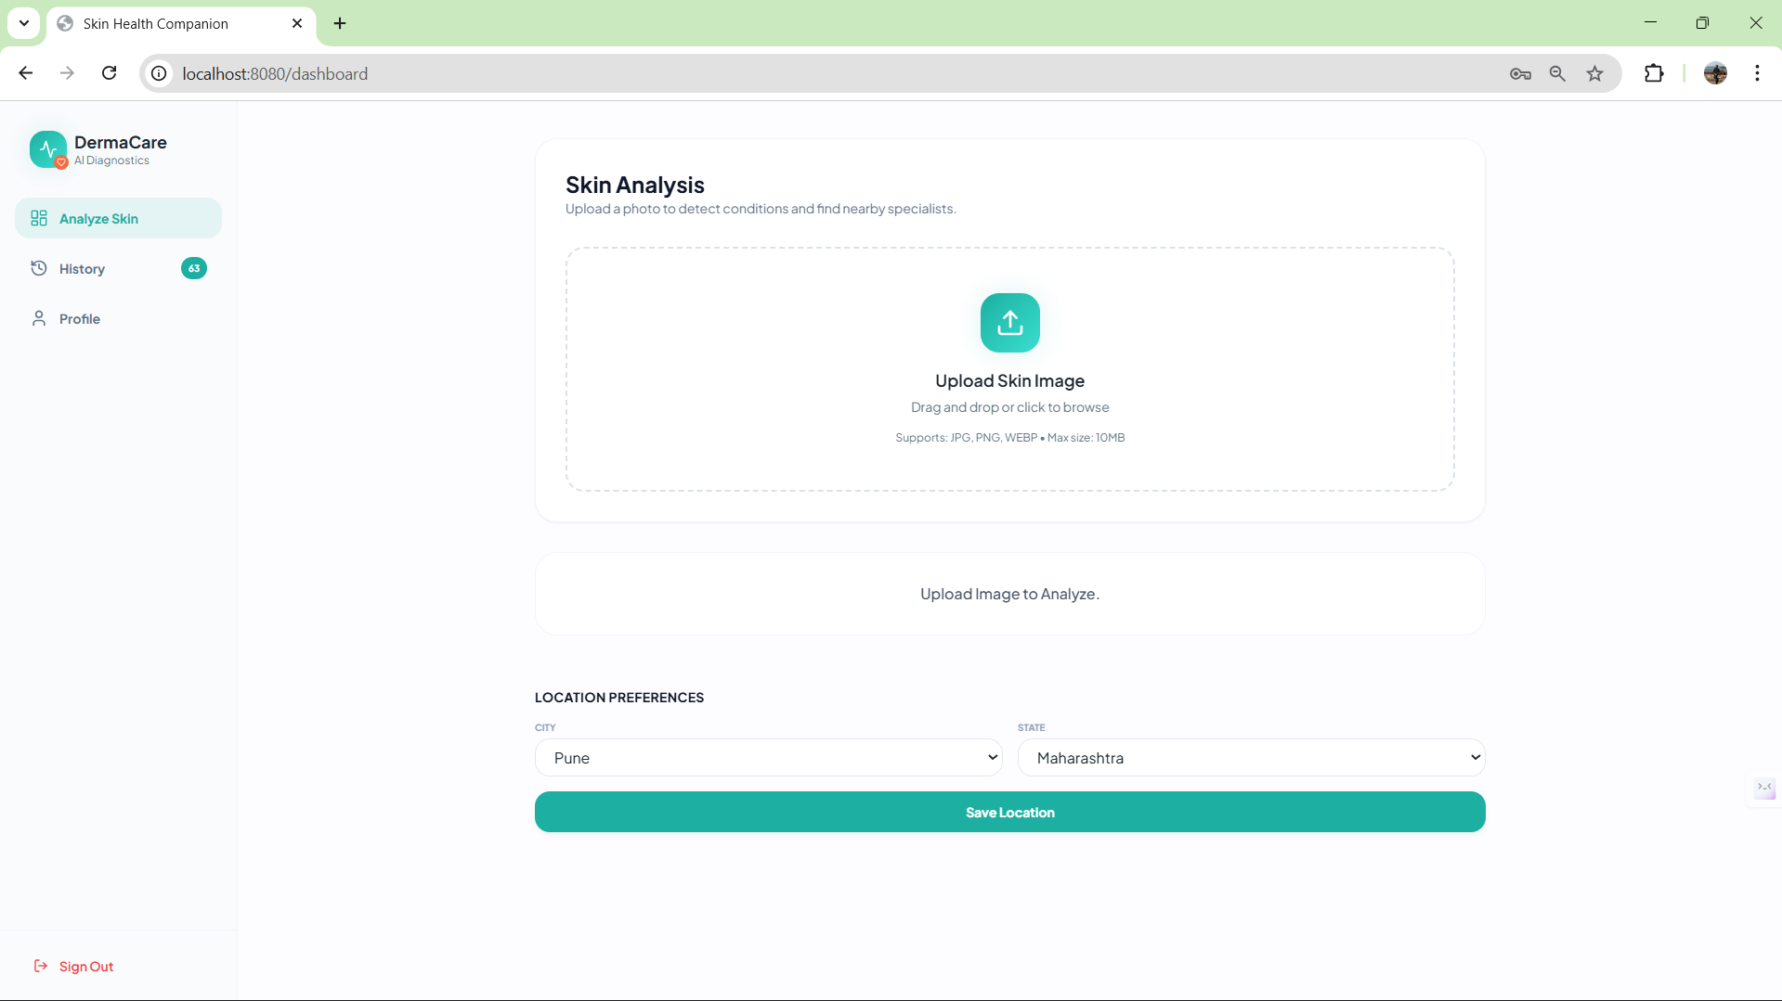
Results:
User Dashboard

Slide 7
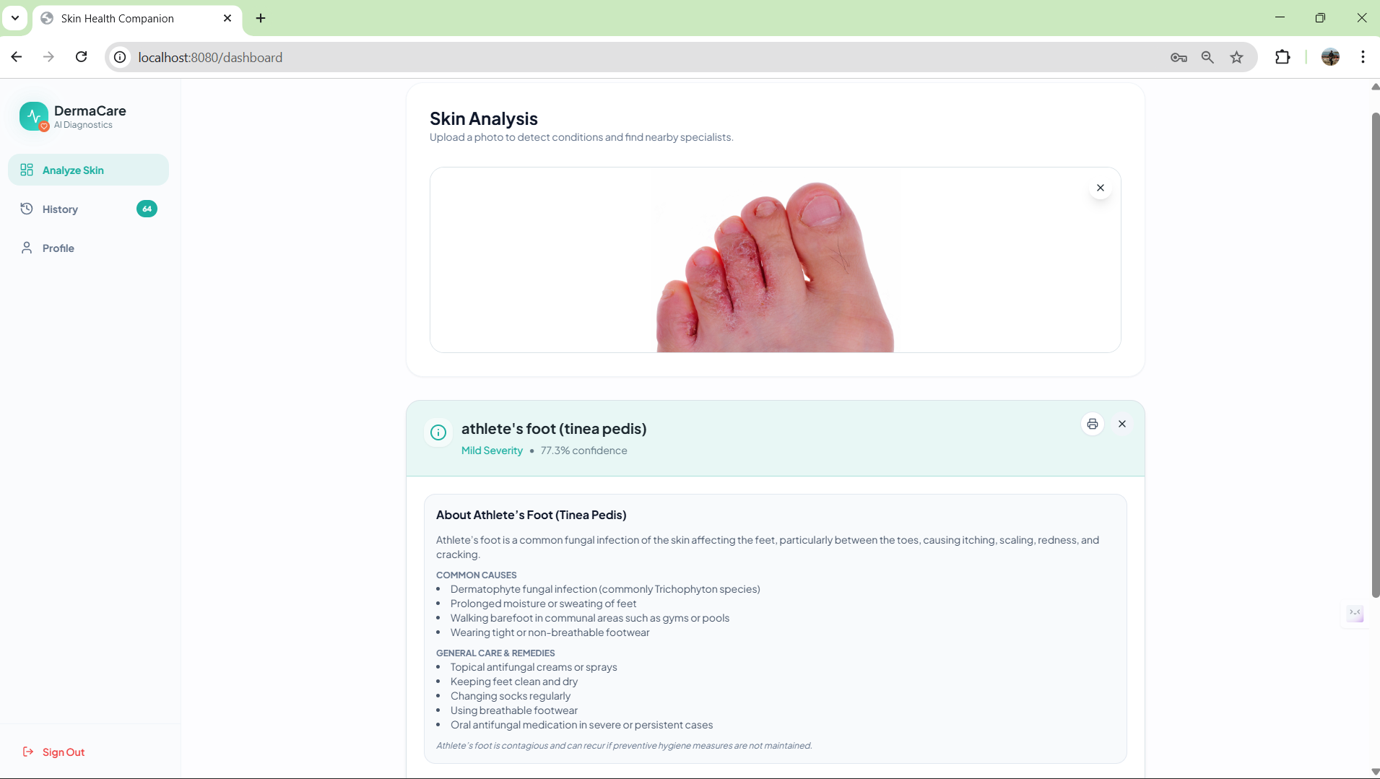
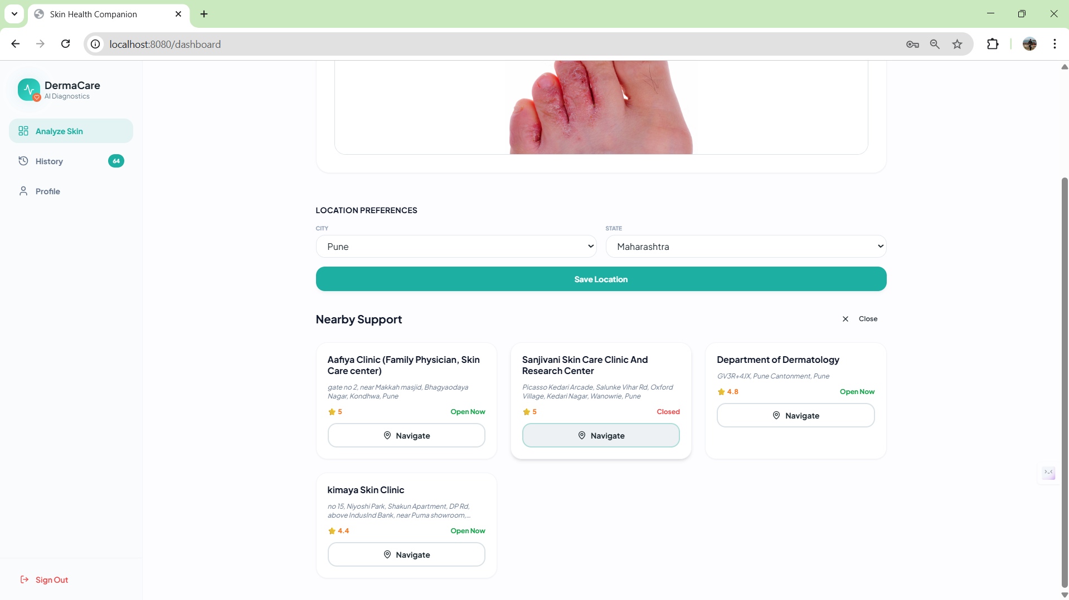
Results:
Skin Disease Detection and
Hospital Recommendation

Slide 8
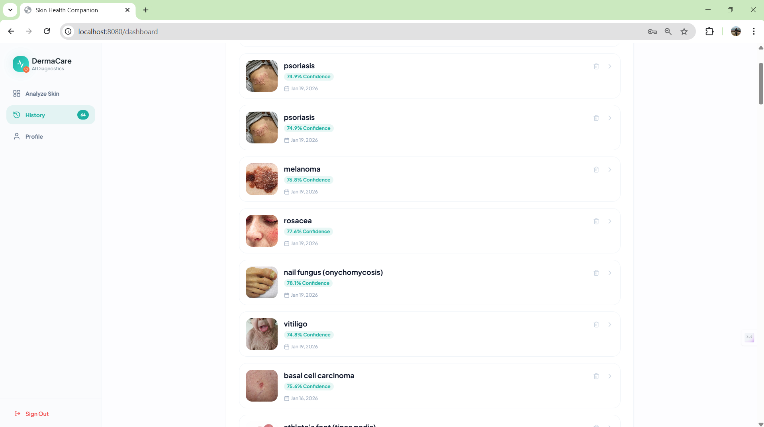
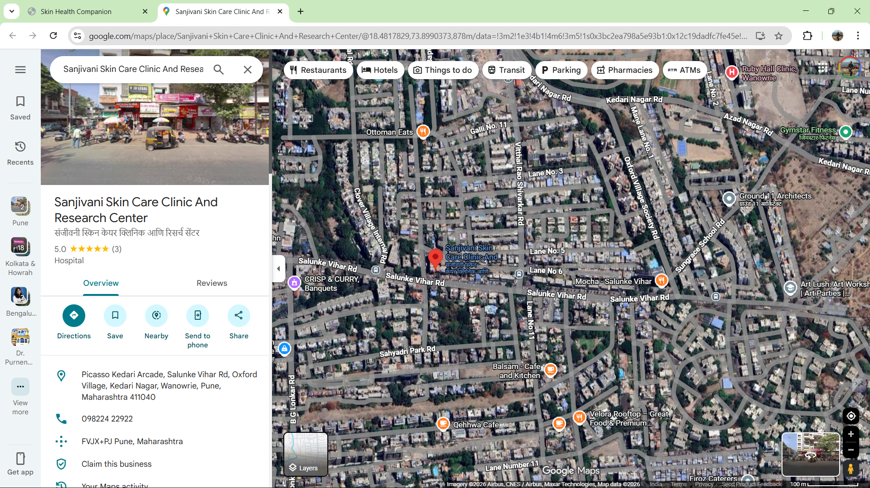
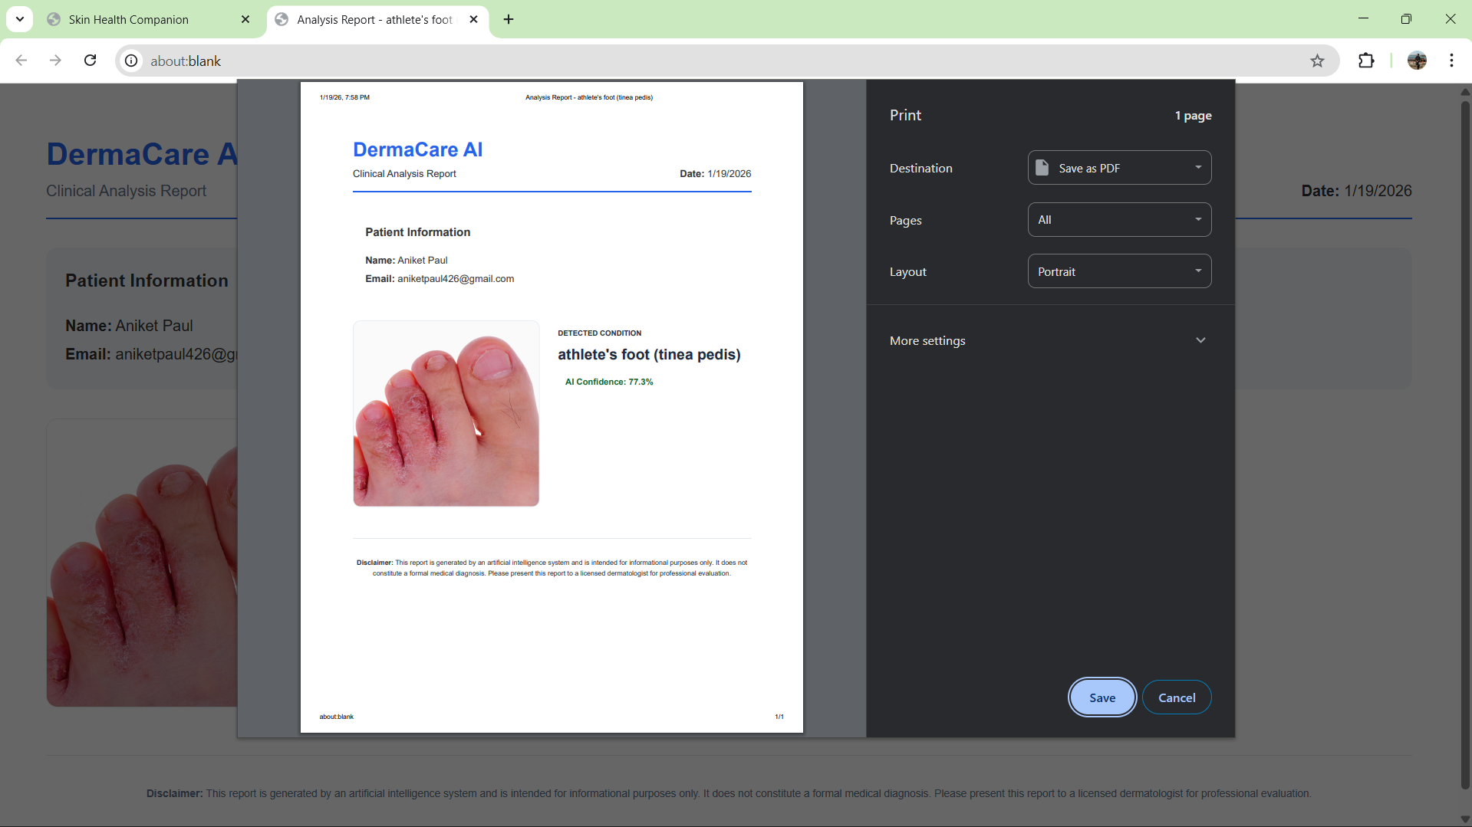
Results:
Google map Location
User upload
history

Slide 9


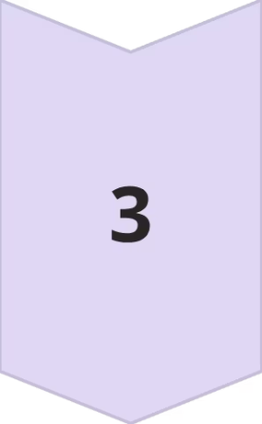
Challenges Faced & Solutions
Challenge 1: Variations in Skin Image Quality
Challenge 2: Accurate Disease Classification
Challenge 3: Integrating Location-Based Healthcare Services
Challenge: Skin images varied due to lighting conditions, camera angles, and resolution, affecting model accuracy.
Solution: Image preprocessing techniques such as resizing, normalization, and enhancement were applied to improve image consistency.
.
Challenge: Many skin diseases share similar visual characteristics, making accurate classification difficult.
Solution: A CNN-based deep learning model was implemented to effectively learn and differentiate disease patterns.
Challenge: Providing accurate and relevant nearby healthcare recommendations was challenging.
Solution: Google Maps API was integrated to display nearby dermatologists and clinics based on user location.

Slide 10
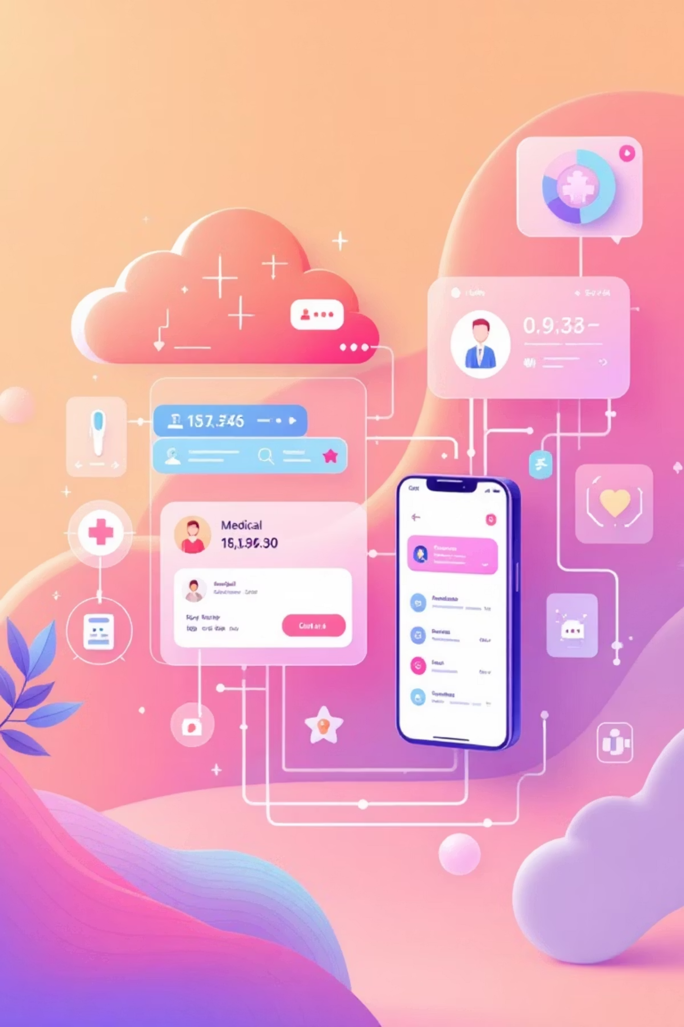
Future Scope: Expanding Our Vision for Digital Health
New Features
Enhancements
Direct dermatologist appointment booking integration for a complete care pathway.
Implementation of multi-model ensemble predictions to further boost diagnostic accuracy.
Development of a dedicated mobile application version for on-the-go access and enhanced user experience.
Development of a continuous model learning system with new data to keep the AI cutting-edge.
Scalability Ideas
Cloud deployment with auto-scaling to handle increasing user demand efficiently.
Introduction of real-time analytics & user dashboards for both patients and providers.

Slide 11



Conclusion
Overall Project Summary
Key Achievements
Learning Outcomes
AI-driven system for skin disease detection
CNN-based disease classification
CNN model development
Combines machine learning model and healthcare services
Seamless frontend–backend integration
FastAPI backend design
Full-stack AI system integration
Location-based healthcare recommendations

Slide 12
THANK
YOU
Thank you for giving us the opportunity to present our project. We welcome your questions and feedback.

